Slide 1
Estado de Resultados DOP
View in Power BI
Last data refresh:
17/01/2024 16:50:47 UTC
Downloaded at:
18/01/2024 22:47:52 UTC

Slide 2
Selección
Notes:
Sel Cine
No alt text provided
Logo cnpls
No alt text provided
Sel Estado
No alt text provided
Sel Marca
No alt text provided
Sel Salas
No alt text provided
Sel Región
No alt text provided
Sel Zona
No alt text provided
Sel Mes
No alt text provided
Sel Trim
No alt text provided
Sel Año
No alt text provided
textbox
No alt text provided
textbox
No alt text provided
card
No alt text provided

Slide 3
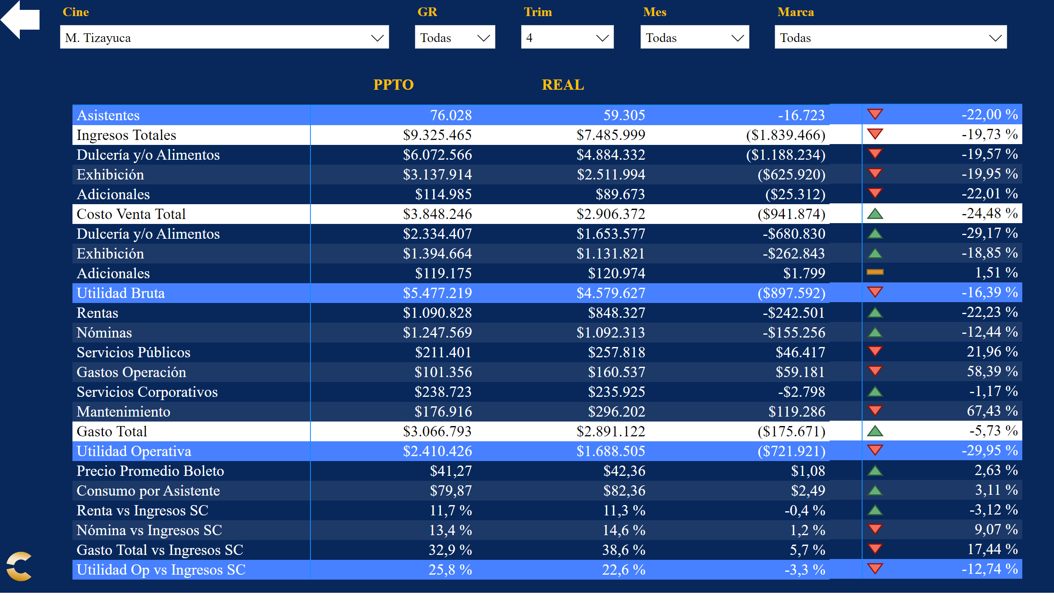
Ppto Resumen
Notes:
Datos Principales
No alt text provided
Dif Ppto
No alt text provided
% Ppto
No alt text provided
Sel Marca
No alt text provided
slicer
No alt text provided
Sel Cine
No alt text provided
Sel Región
No alt text provided
slicer
No alt text provided
Sel Mes
No alt text provided
slicer
No alt text provided
slicer
No alt text provided
Sel Trim
No alt text provided
Panel
No alt text provided
Atras
No alt text provided
Logo cnpls
No alt text provided

Slide 4
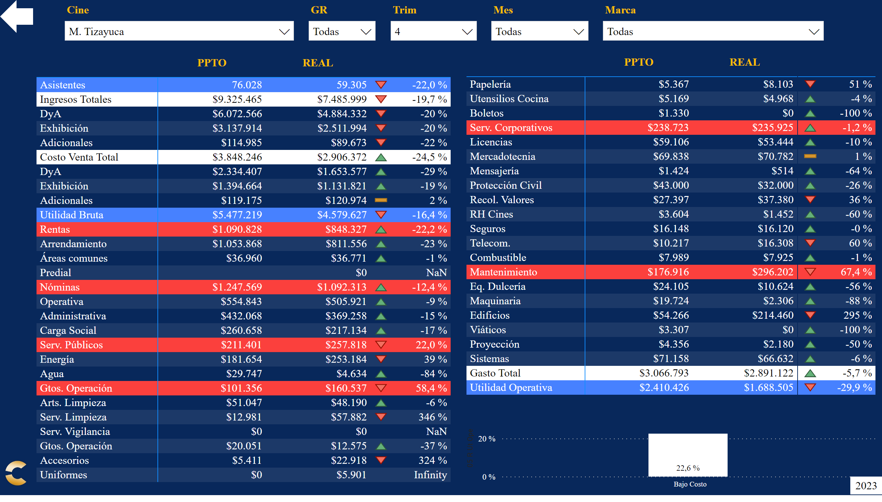
Ppto Detalle
Notes:
Datos 1
No alt text provided
% Ppto 1
No alt text provided
Sel Marca
No alt text provided
slicer
No alt text provided
Sel Cine
No alt text provided
Sel Región
No alt text provided
slicer
No alt text provided
Sel Mes
No alt text provided
slicer
No alt text provided
slicer
No alt text provided
Sel Trim
No alt text provided
Panel
No alt text provided
Atras
No alt text provided
Logo cnpls
No alt text provided
Datos 2
No alt text provided
% Ppto 2
No alt text provided
Tarjeta Actual
No alt text provided
columnChart
No alt text provided

Slide 5
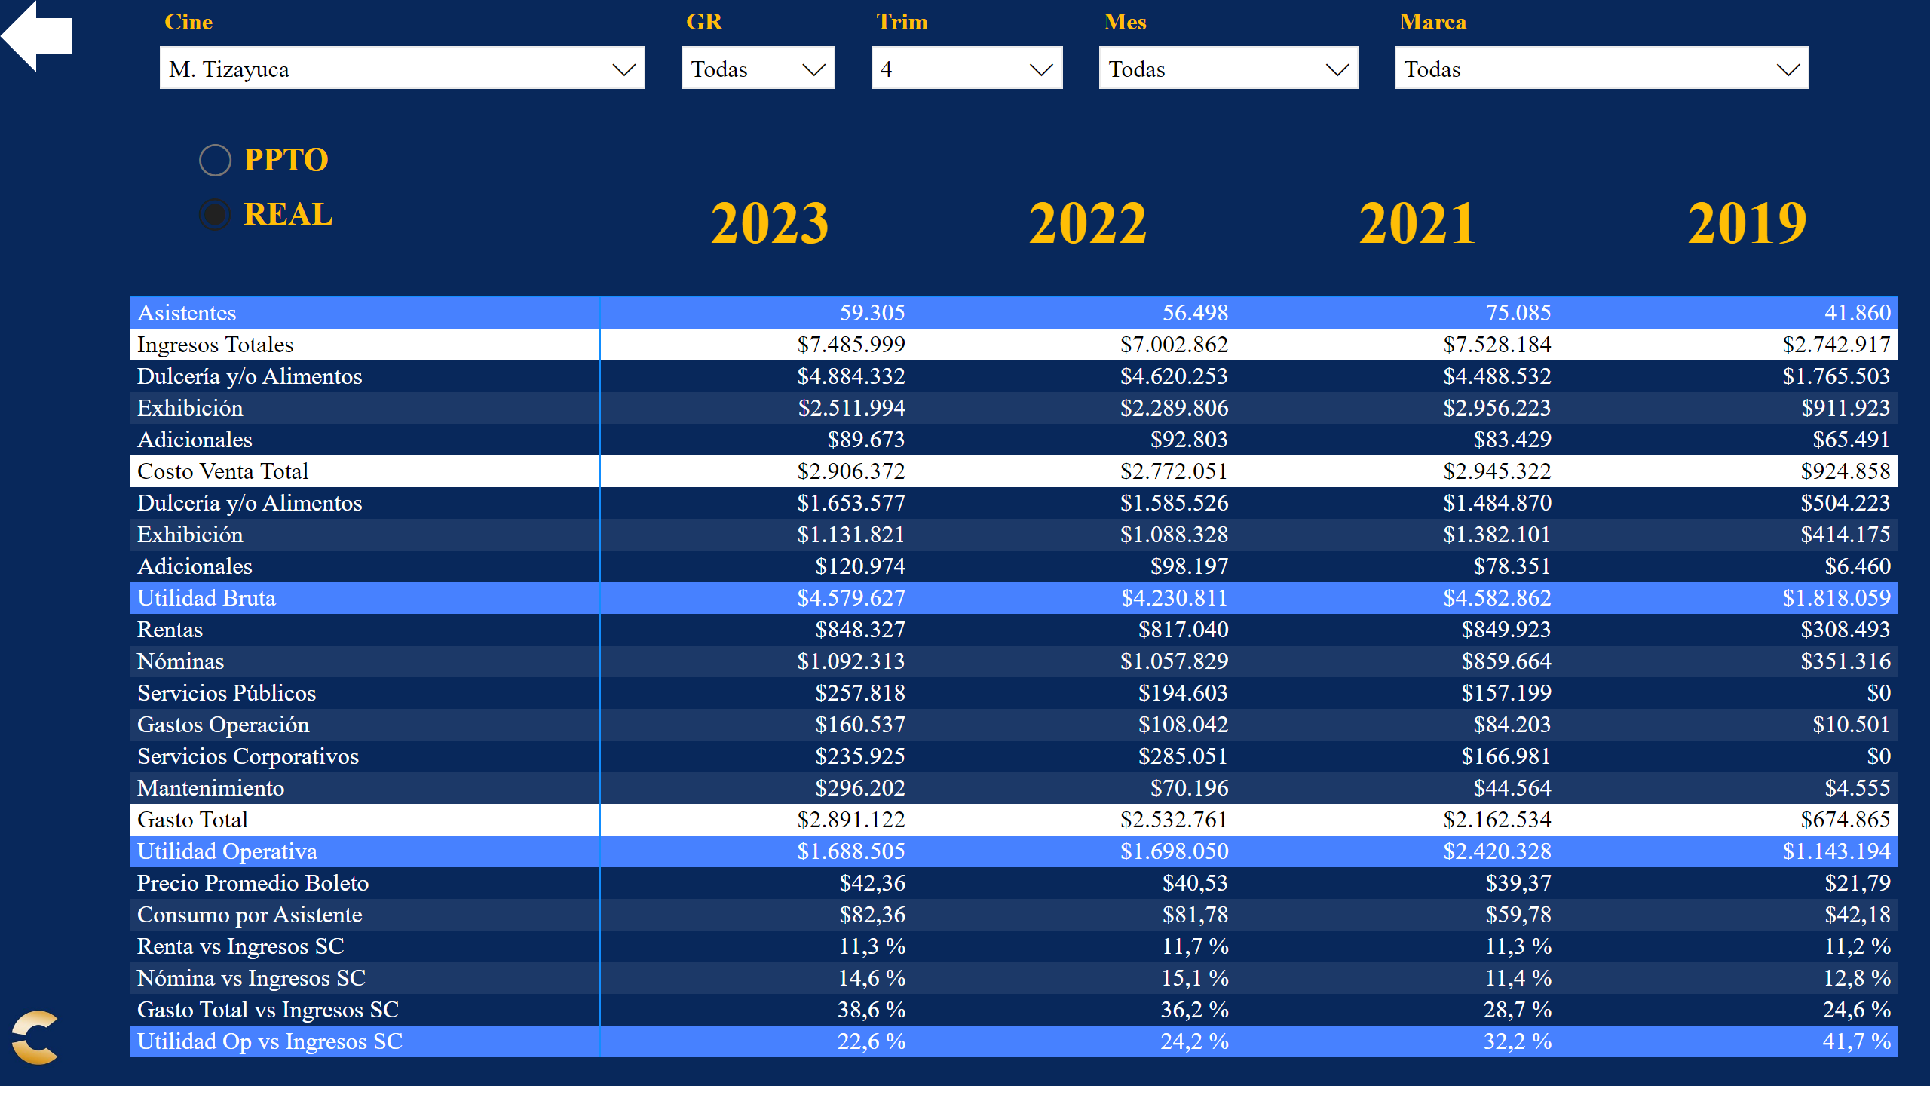
Años
Notes:
Datos Principales
No alt text provided
Sel Marca
No alt text provided
slicer
No alt text provided
Sel Cine
No alt text provided
Sel Región
No alt text provided
slicer
No alt text provided
Sel Mes
No alt text provided
slicer
No alt text provided
slicer
No alt text provided
Sel Trim
No alt text provided
Panel
No alt text provided
Atras
No alt text provided
Logo cnpls
No alt text provided
Sel Tipo
No alt text provided
Datos AA
No alt text provided
Datos AA2
No alt text provided
Datos 19
No alt text provided
T Año Acttual
No alt text provided
T Año AA
No alt text provided
T Año AAx2
No alt text provided
T Año 2019
No alt text provided

Slide 6
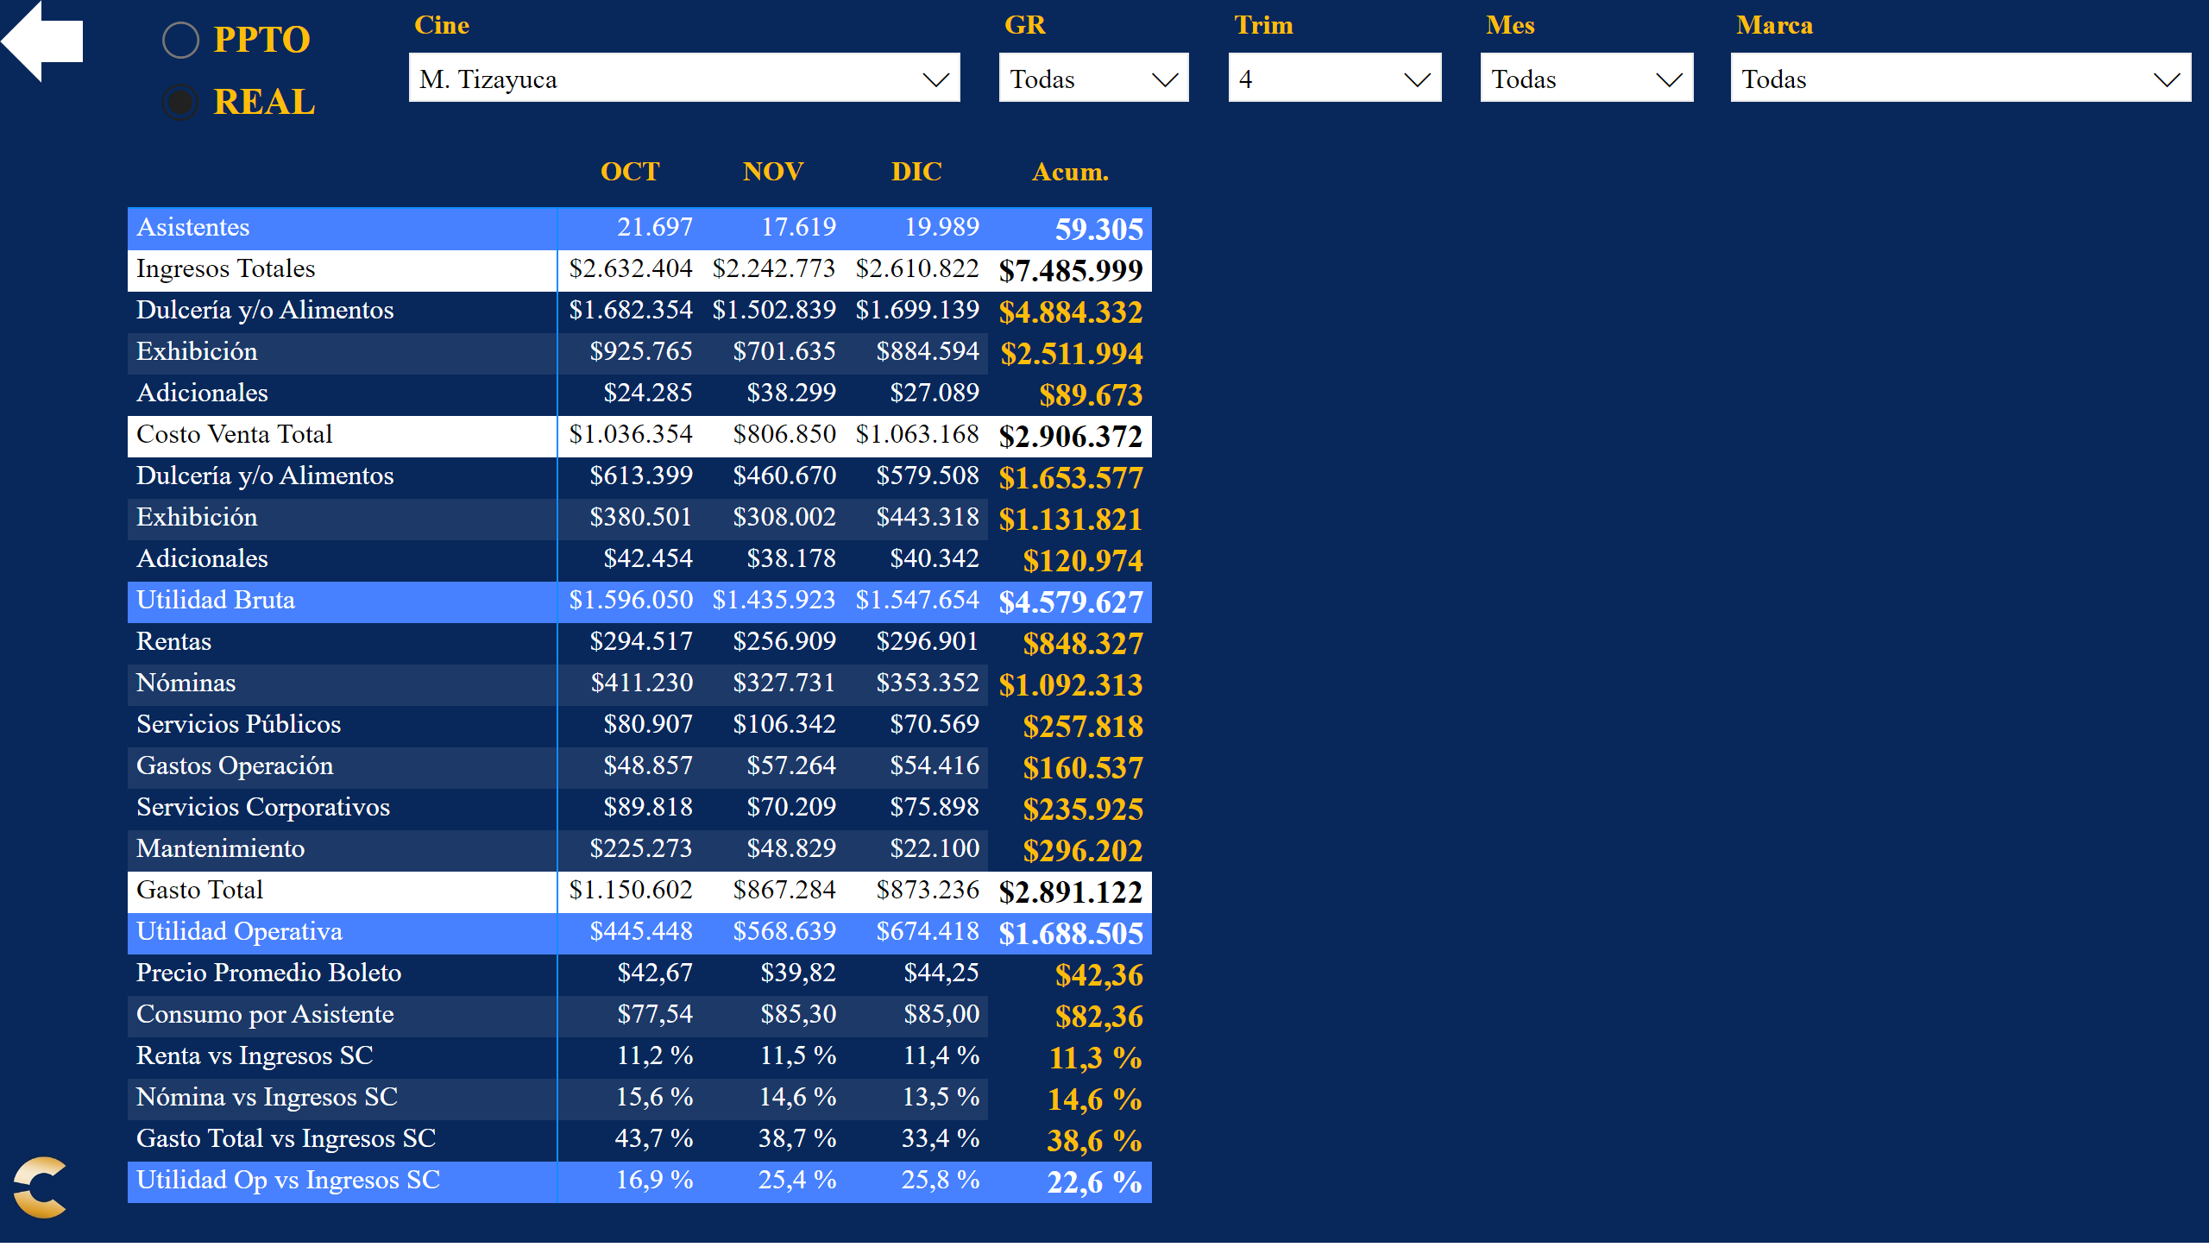
Meses
Notes:
Datos Principales
No alt text provided
Sel Marca
No alt text provided
slicer
No alt text provided
Sel Cine
No alt text provided
Sel Región
No alt text provided
slicer
No alt text provided
Sel Mes
No alt text provided
slicer
No alt text provided
slicer
No alt text provided
Sel Trim
No alt text provided
Panel
No alt text provided
Atras
No alt text provided
Logo cnpls
No alt text provided
Sel Tipo
No alt text provided

Slide 7
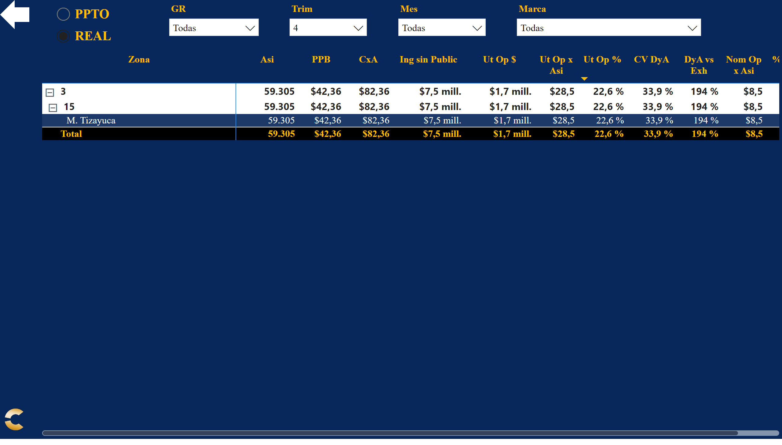
KPI
Notes:
Datos
No alt text provided
Sel Marca
No alt text provided
slicer
No alt text provided
slicer
No alt text provided
Sel Región
No alt text provided
slicer
No alt text provided
Sel Mes
No alt text provided
slicer
No alt text provided
slicer
No alt text provided
Sel Trim
No alt text provided
Panel
No alt text provided
Atras
No alt text provided
Logo cnpls
No alt text provided
Sel Tipo
No alt text provided

Slide 8
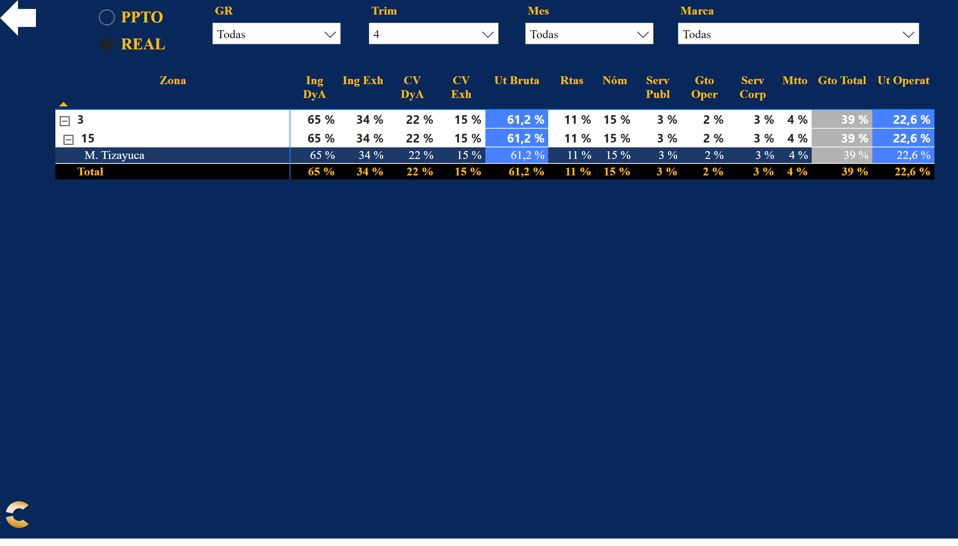
KPI %
Notes:
Datos
No alt text provided
Sel Marca
No alt text provided
slicer
No alt text provided
slicer
No alt text provided
Sel Región
No alt text provided
slicer
No alt text provided
Sel Mes
No alt text provided
slicer
No alt text provided
slicer
No alt text provided
Sel Trim
No alt text provided
Panel
No alt text provided
Atras
No alt text provided
Logo cnpls
No alt text provided
Sel Tipo
No alt text provided

Slide 9
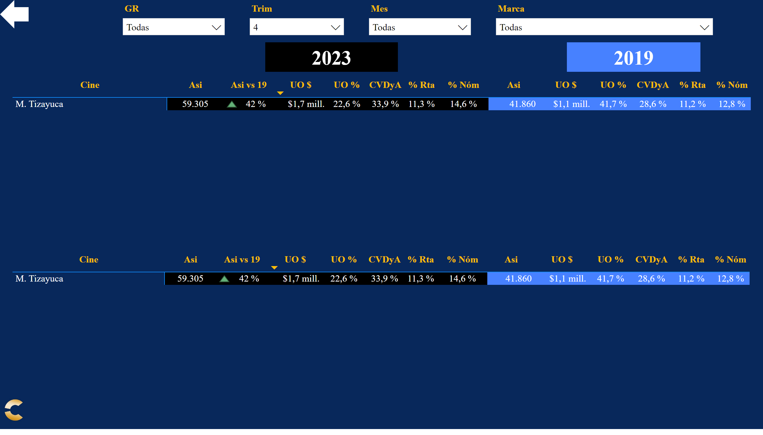
Top/Bottom
Notes:
Top
No alt text provided
Sel Marca
No alt text provided
slicer
No alt text provided
slicer
No alt text provided
Sel Región
No alt text provided
slicer
No alt text provided
Sel Mes
No alt text provided
slicer
No alt text provided
slicer
No alt text provided
Sel Trim
No alt text provided
Panel
No alt text provided
Atras
No alt text provided
Logo cnpls
No alt text provided
slicer
No alt text provided
T Año Acttual
No alt text provided
T Año Acttual
No alt text provided
Bottom
No alt text provided

Slide 10
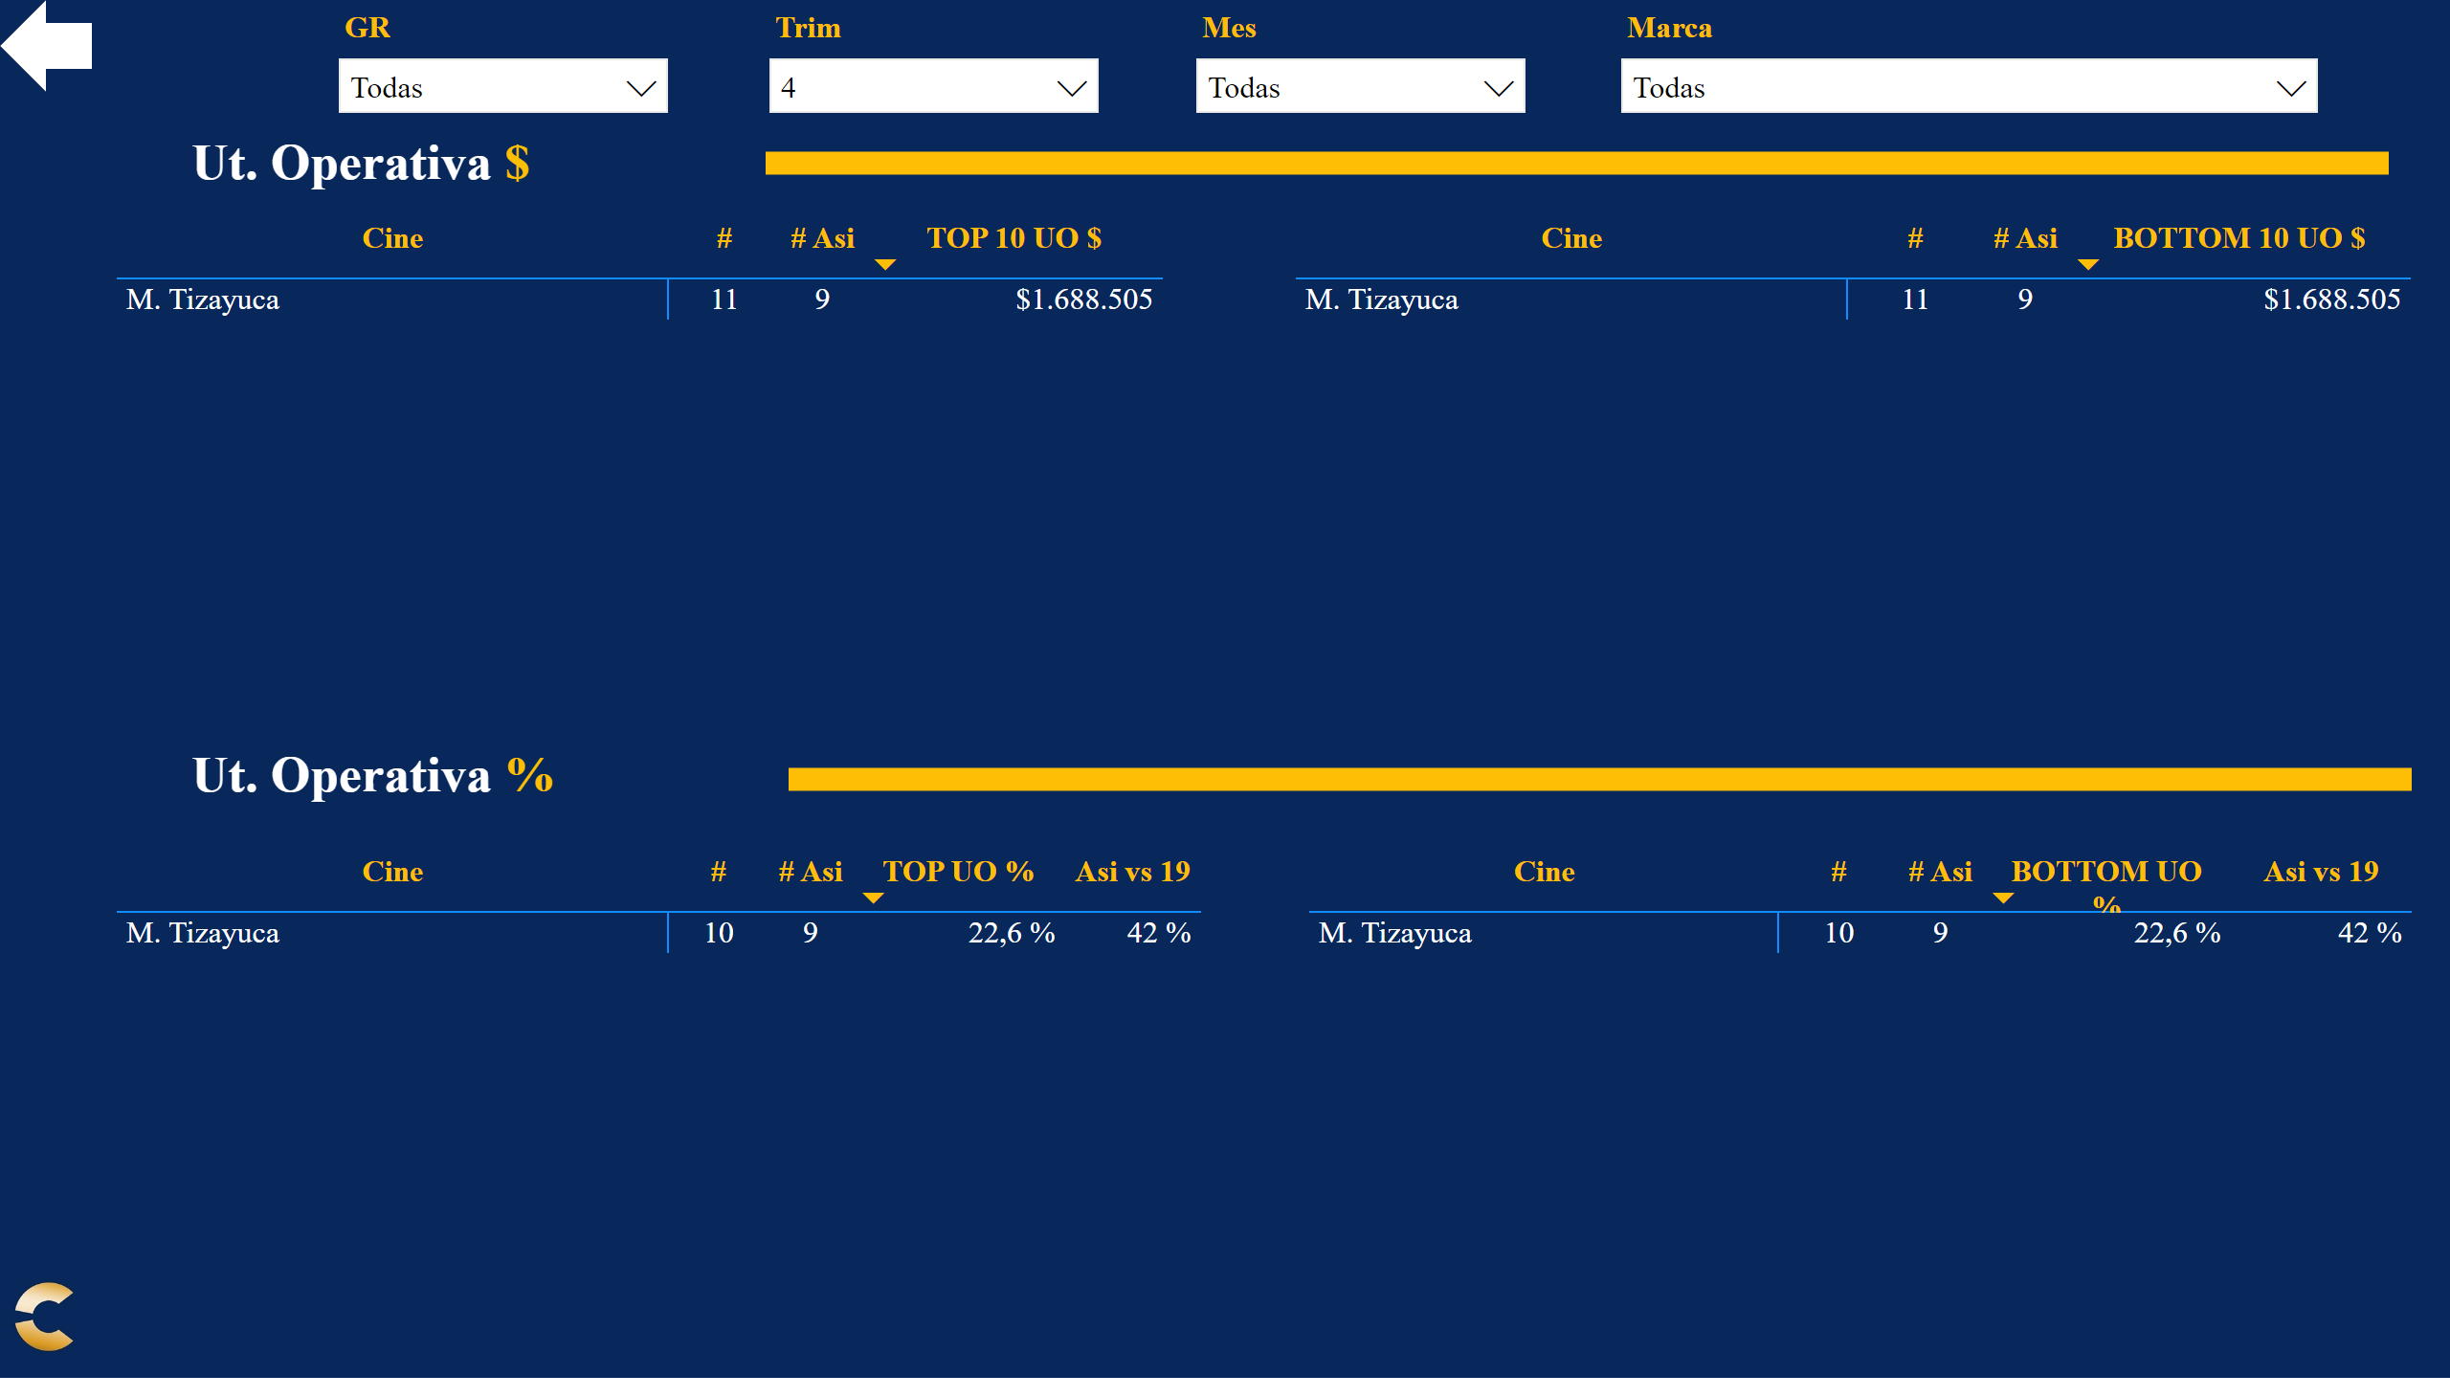
Top/ Bot Resumen
Notes:
Top
No alt text provided
Sel Marca
No alt text provided
slicer
No alt text provided
slicer
No alt text provided
Sel Región
No alt text provided
slicer
No alt text provided
Sel Mes
No alt text provided
slicer
No alt text provided
slicer
No alt text provided
Sel Trim
No alt text provided
Panel
No alt text provided
Atras
No alt text provided
Logo cnpls
No alt text provided
slicer
No alt text provided
Top
No alt text provided
Top
No alt text provided
Top
No alt text provided
textbox
No alt text provided
textbox
No alt text provided
shape
No alt text provided
shape
No alt text provided

Slide 11
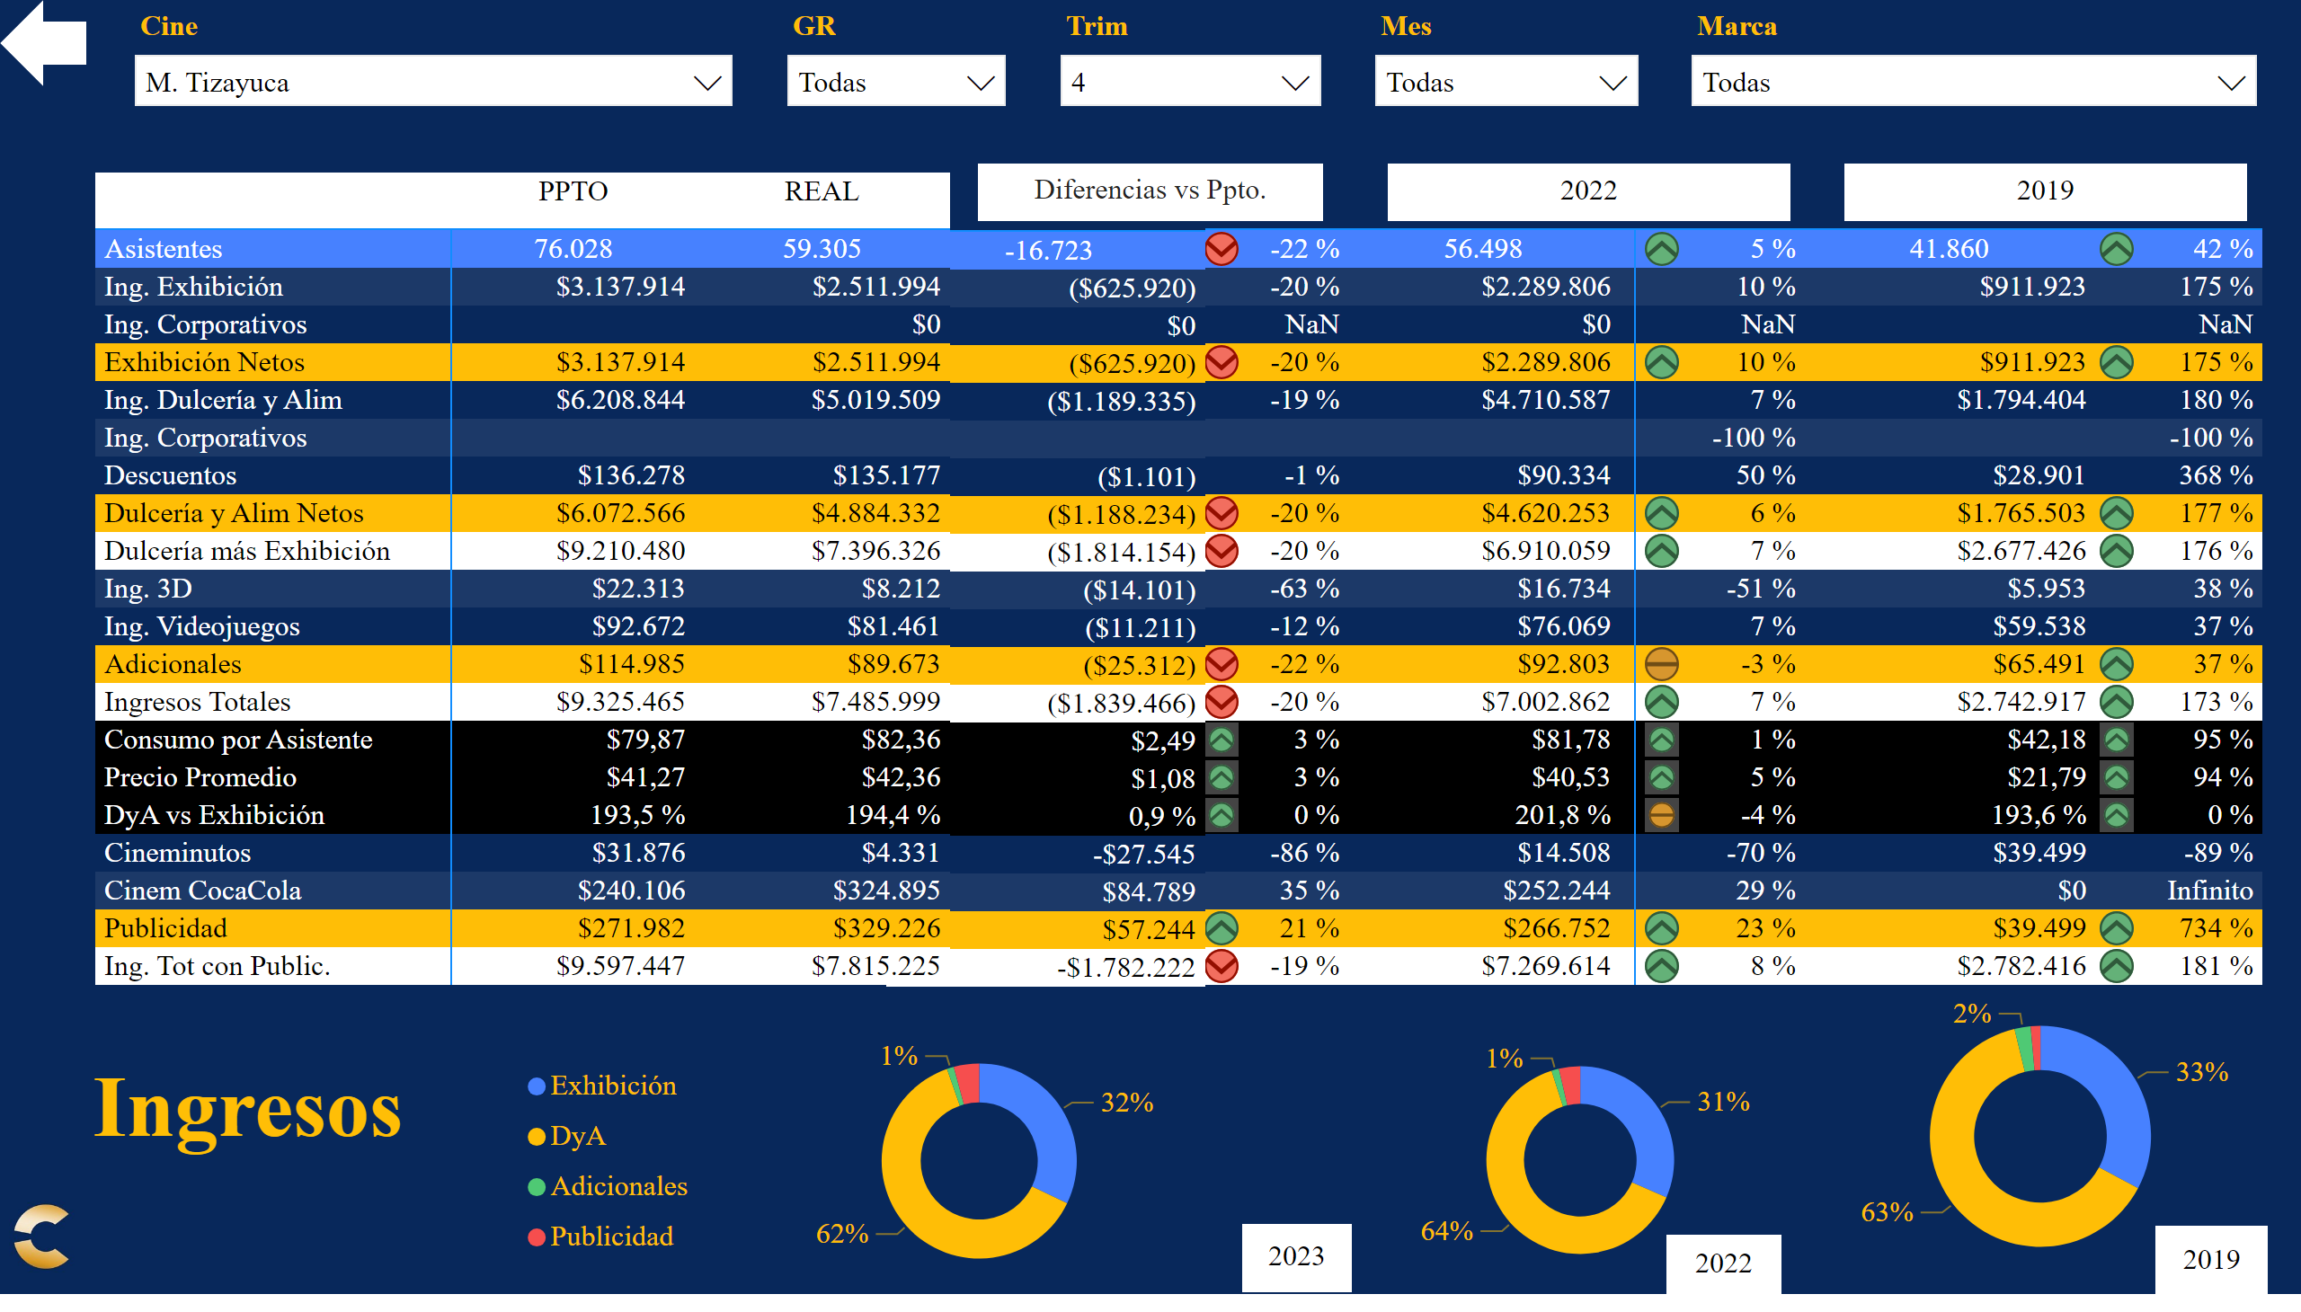
ING
Notes:
textbox
No alt text provided
Datos Principales
No alt text provided
Dif Ppto
No alt text provided
% Ppto
No alt text provided
donutChart
No alt text provided
Tarjeta AA
No alt text provided
Tarjeta AA
No alt text provided
% AA
No alt text provided
Datos AA
No alt text provided
Tarjeta 19
No alt text provided
Datos 19
No alt text provided
% 19
No alt text provided
donutChart
No alt text provided
Tarjeta Actual
No alt text provided
Tarjeta 19
No alt text provided
donutChart
No alt text provided
slicer
No alt text provided
Sel Trim
No alt text provided
Sel Mes
No alt text provided
slicer
No alt text provided
Sel Región
No alt text provided
slicer
No alt text provided
Sel Marca
No alt text provided
slicer
No alt text provided
Sel Cine
No alt text provided
textbox
No alt text provided
Panel
No alt text provided
Atras
No alt text provided
Logo cnpls
No alt text provided

Slide 12
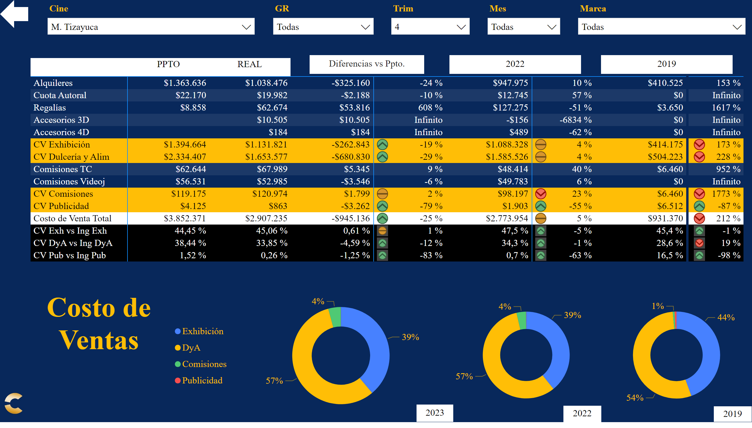
CVT
Notes:
textbox
No alt text provided
Datos Principales
No alt text provided
Dif Ppto
No alt text provided
% Ppto
No alt text provided
donutChart
No alt text provided
Tarjeta AA
No alt text provided
donutChart
No alt text provided
Tarjeta Actual
No alt text provided
donutChart
No alt text provided
Tarjeta 19
No alt text provided
Tarjeta AA
No alt text provided
Datos AA
No alt text provided
% AA
No alt text provided
Tarjeta 19
No alt text provided
Datos 19
No alt text provided
% 19
No alt text provided
slicer
No alt text provided
Sel Trim
No alt text provided
Sel Mes
No alt text provided
slicer
No alt text provided
Sel Región
No alt text provided
slicer
No alt text provided
Sel Marca
No alt text provided
slicer
No alt text provided
Sel Cine
No alt text provided
textbox
No alt text provided
Panel
No alt text provided
Atras
No alt text provided
Logo cnpls
No alt text provided

Slide 13
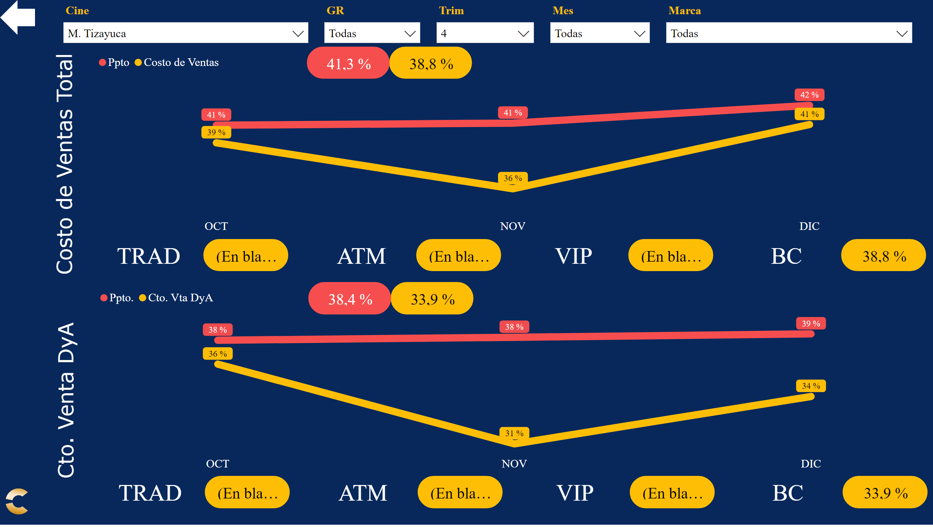
CVG
Notes:
slicer
No alt text provided
Sel Trim
No alt text provided
Sel Mes
No alt text provided
slicer
No alt text provided
Sel Región
No alt text provided
slicer
No alt text provided
Sel Marca
No alt text provided
slicer
No alt text provided
Sel Cine
No alt text provided
Panel
No alt text provided
Atras
No alt text provided
Logo cnpls
No alt text provided
REA
No alt text provided
Título
No alt text provided
PPT
No alt text provided
TRA
No alt text provided
TRA1
No alt text provided
TRA
No alt text provided
TRA1
No alt text provided
TRA
No alt text provided
TRA1
No alt text provided
TRA
No alt text provided
TRA1
No alt text provided
Gráfica
No alt text provided
REA
No alt text provided
Título
No alt text provided
PPT
No alt text provided
TRA
No alt text provided
TRA1
No alt text provided
TRA
No alt text provided
TRA1
No alt text provided
TRA
No alt text provided
TRA1
No alt text provided
TRA
No alt text provided
TRA1
No alt text provided
Gráfica
No alt text provided

Slide 14
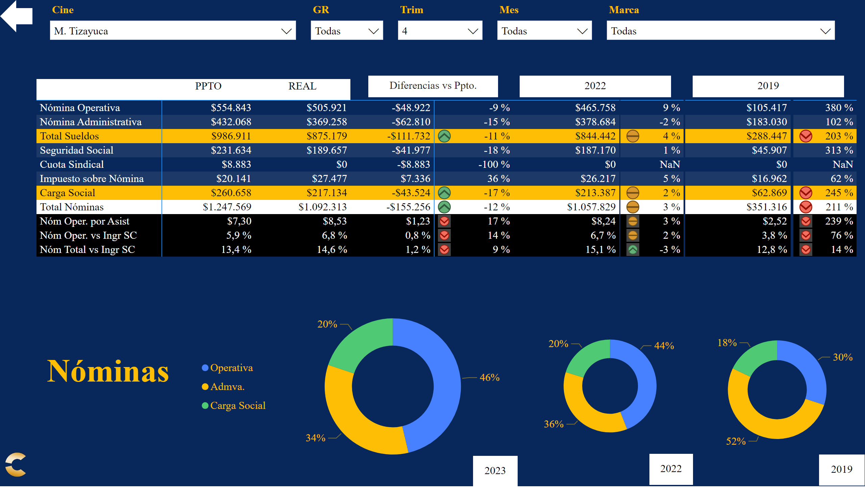
NOM
Notes:
textbox
No alt text provided
Datos Principales
No alt text provided
Dif Ppto
No alt text provided
% Ppto
No alt text provided
donutChart
No alt text provided
Tarjeta AA
No alt text provided
donutChart
No alt text provided
Tarjeta Actual
No alt text provided
donutChart
No alt text provided
Tarjeta 19
No alt text provided
Tarjeta AA
No alt text provided
Datos AA
No alt text provided
% AA
No alt text provided
Tarjeta 19
No alt text provided
Datos 19
No alt text provided
% 19
No alt text provided
slicer
No alt text provided
Sel Trim
No alt text provided
Sel Mes
No alt text provided
slicer
No alt text provided
Sel Región
No alt text provided
slicer
No alt text provided
Sel Marca
No alt text provided
slicer
No alt text provided
Sel Cine
No alt text provided
textbox
No alt text provided
Panel
No alt text provided
Atras
No alt text provided
Logo cnpls
No alt text provided

Slide 15
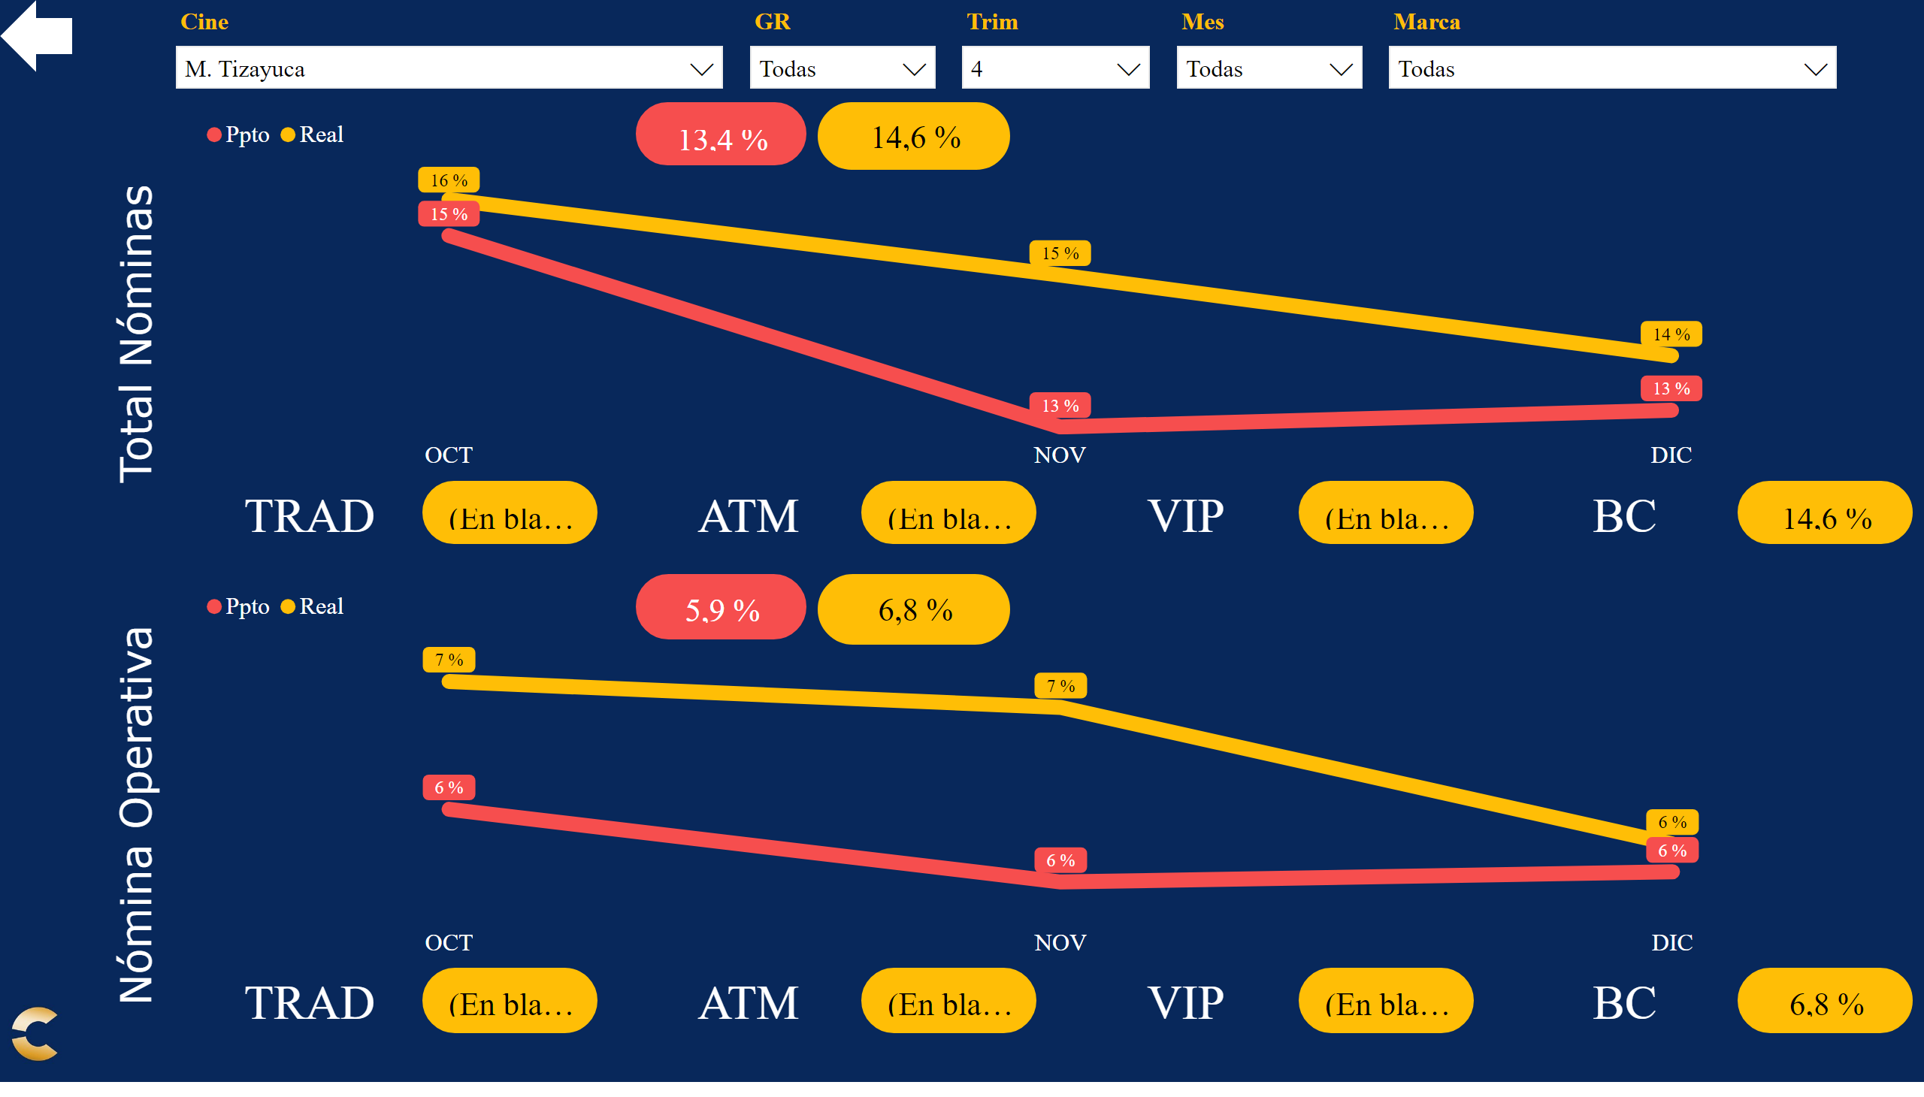
NOG
Notes:
slicer
No alt text provided
Sel Trim
No alt text provided
Sel Mes
No alt text provided
slicer
No alt text provided
Sel Región
No alt text provided
slicer
No alt text provided
Sel Marca
No alt text provided
slicer
No alt text provided
Sel Cine
No alt text provided
Panel
No alt text provided
Atras
No alt text provided
Logo cnpls
No alt text provided
REA
No alt text provided
Título
No alt text provided
PPT
No alt text provided
TRA
No alt text provided
TRA1
No alt text provided
TRA
No alt text provided
TRA1
No alt text provided
TRA
No alt text provided
TRA1
No alt text provided
TRA
No alt text provided
TRA1
No alt text provided
Gráfica
No alt text provided
REA
No alt text provided
Título
No alt text provided
PPT
No alt text provided
TRA
No alt text provided
TRA1
No alt text provided
TRA
No alt text provided
TRA1
No alt text provided
TRA
No alt text provided
TRA1
No alt text provided
TRA
No alt text provided
TRA1
No alt text provided
Gráfica
No alt text provided

Slide 16
RTA
Notes:
textbox
No alt text provided
Datos Principales
No alt text provided
Dif Ppto
No alt text provided
% Ppto
No alt text provided
Tarjeta 19
No alt text provided
Datos 19
No alt text provided
% 19
No alt text provided
Tarjeta 19
No alt text provided
Datos 19
No alt text provided
% 19
No alt text provided
Lineas % vs Ingresos
No alt text provided
Lineas % vs Ingresos
No alt text provided
slicer
No alt text provided
Sel Trim
No alt text provided
Sel Mes
No alt text provided
slicer
No alt text provided
Sel Región
No alt text provided
slicer
No alt text provided
Sel Marca
No alt text provided
slicer
No alt text provided
Sel Cine
No alt text provided
textbox
No alt text provided
textbox
No alt text provided
Panel
No alt text provided
Atras
No alt text provided
Logo cnpls
No alt text provided

Slide 17
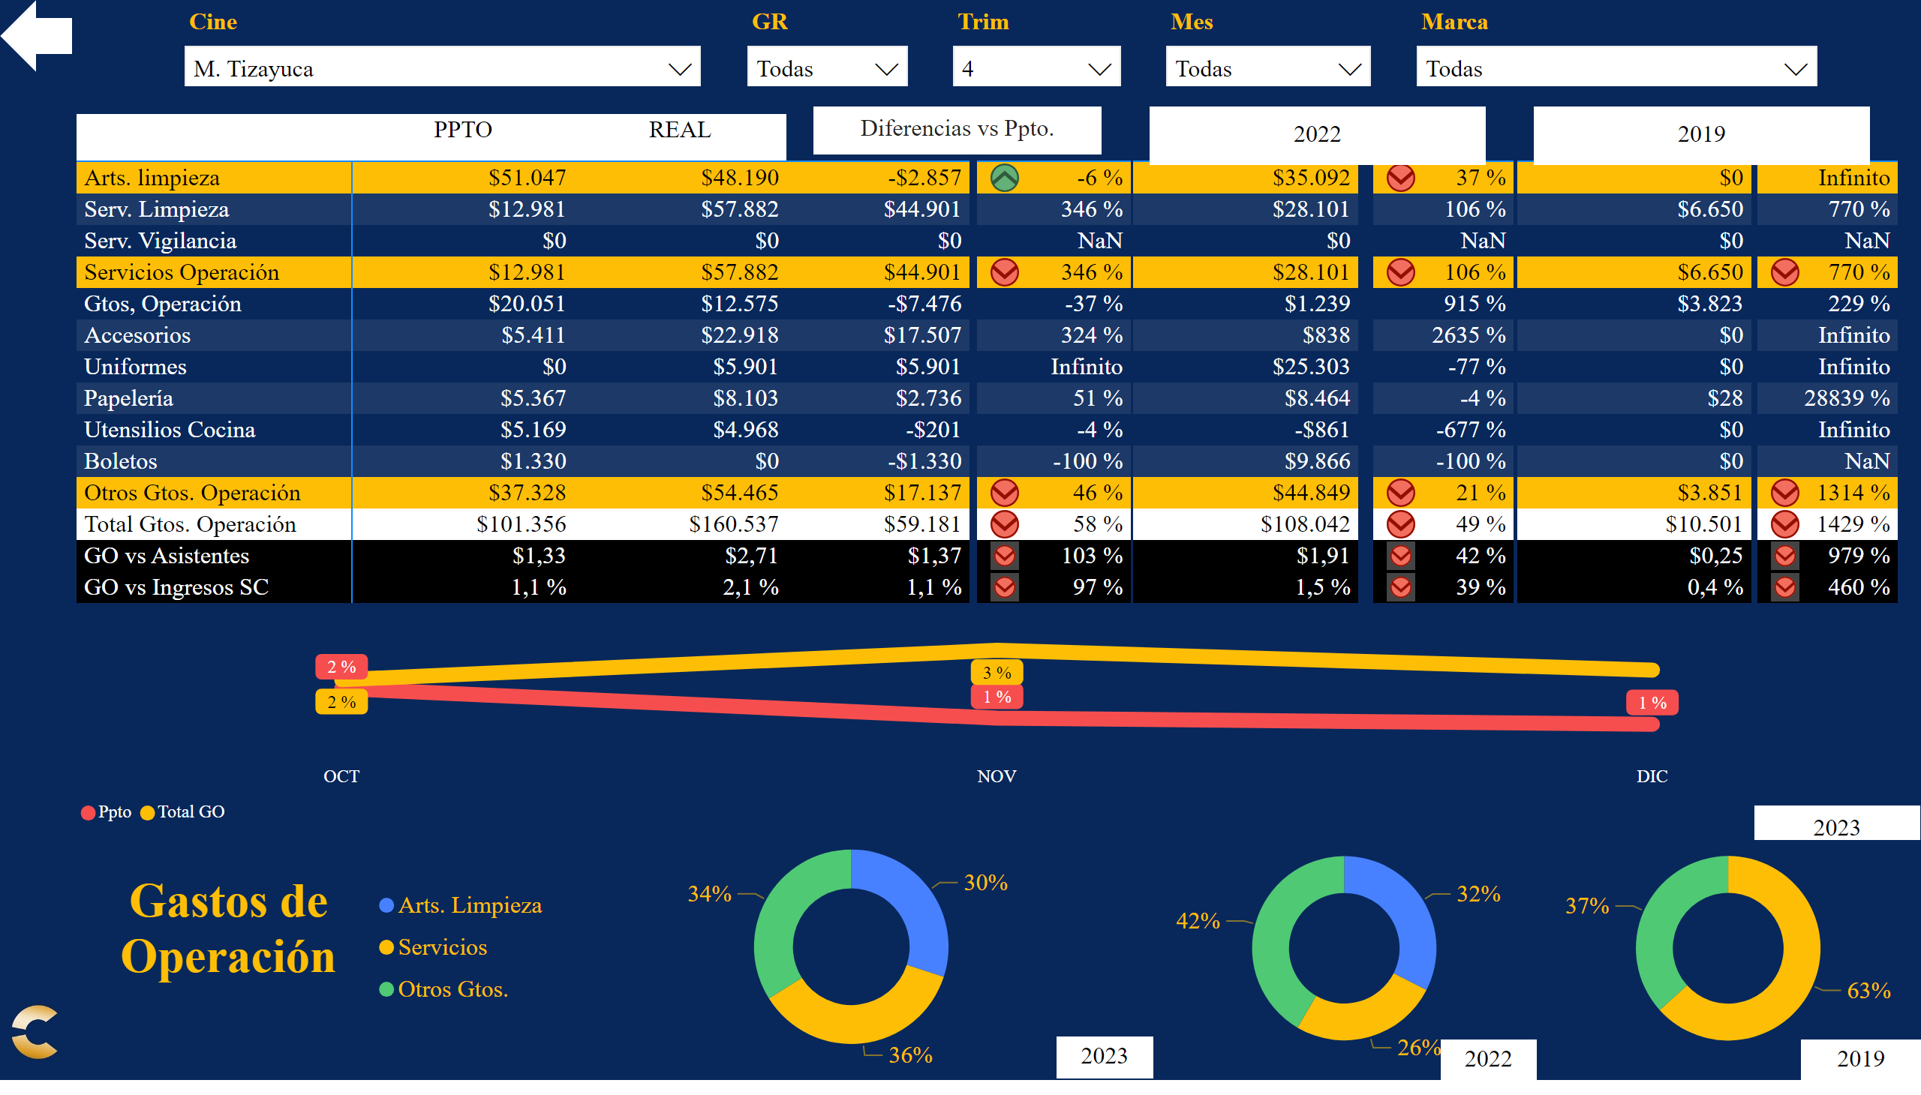
GTO
Notes:
textbox
No alt text provided
Datos Principales
No alt text provided
Dif Ppto
No alt text provided
% Ppto
No alt text provided
donutChart
No alt text provided
Tarjeta AA
No alt text provided
donutChart
No alt text provided
Tarjeta Actual
No alt text provided
donutChart
No alt text provided
Tarjeta 19
No alt text provided
Tarjeta 19
No alt text provided
Datos 19
No alt text provided
% 19
No alt text provided
Tarjeta 19
No alt text provided
Datos 19
No alt text provided
% 19
No alt text provided
Lineas % vs Ingresos
No alt text provided
Tarjeta Actual
No alt text provided
slicer
No alt text provided
Sel Trim
No alt text provided
Sel Mes
No alt text provided
slicer
No alt text provided
Sel Región
No alt text provided
slicer
No alt text provided
Sel Marca
No alt text provided
slicer
No alt text provided
Sel Cine
No alt text provided
textbox
No alt text provided
Panel
No alt text provided
Atras
No alt text provided
Logo cnpls
No alt text provided

Slide 18
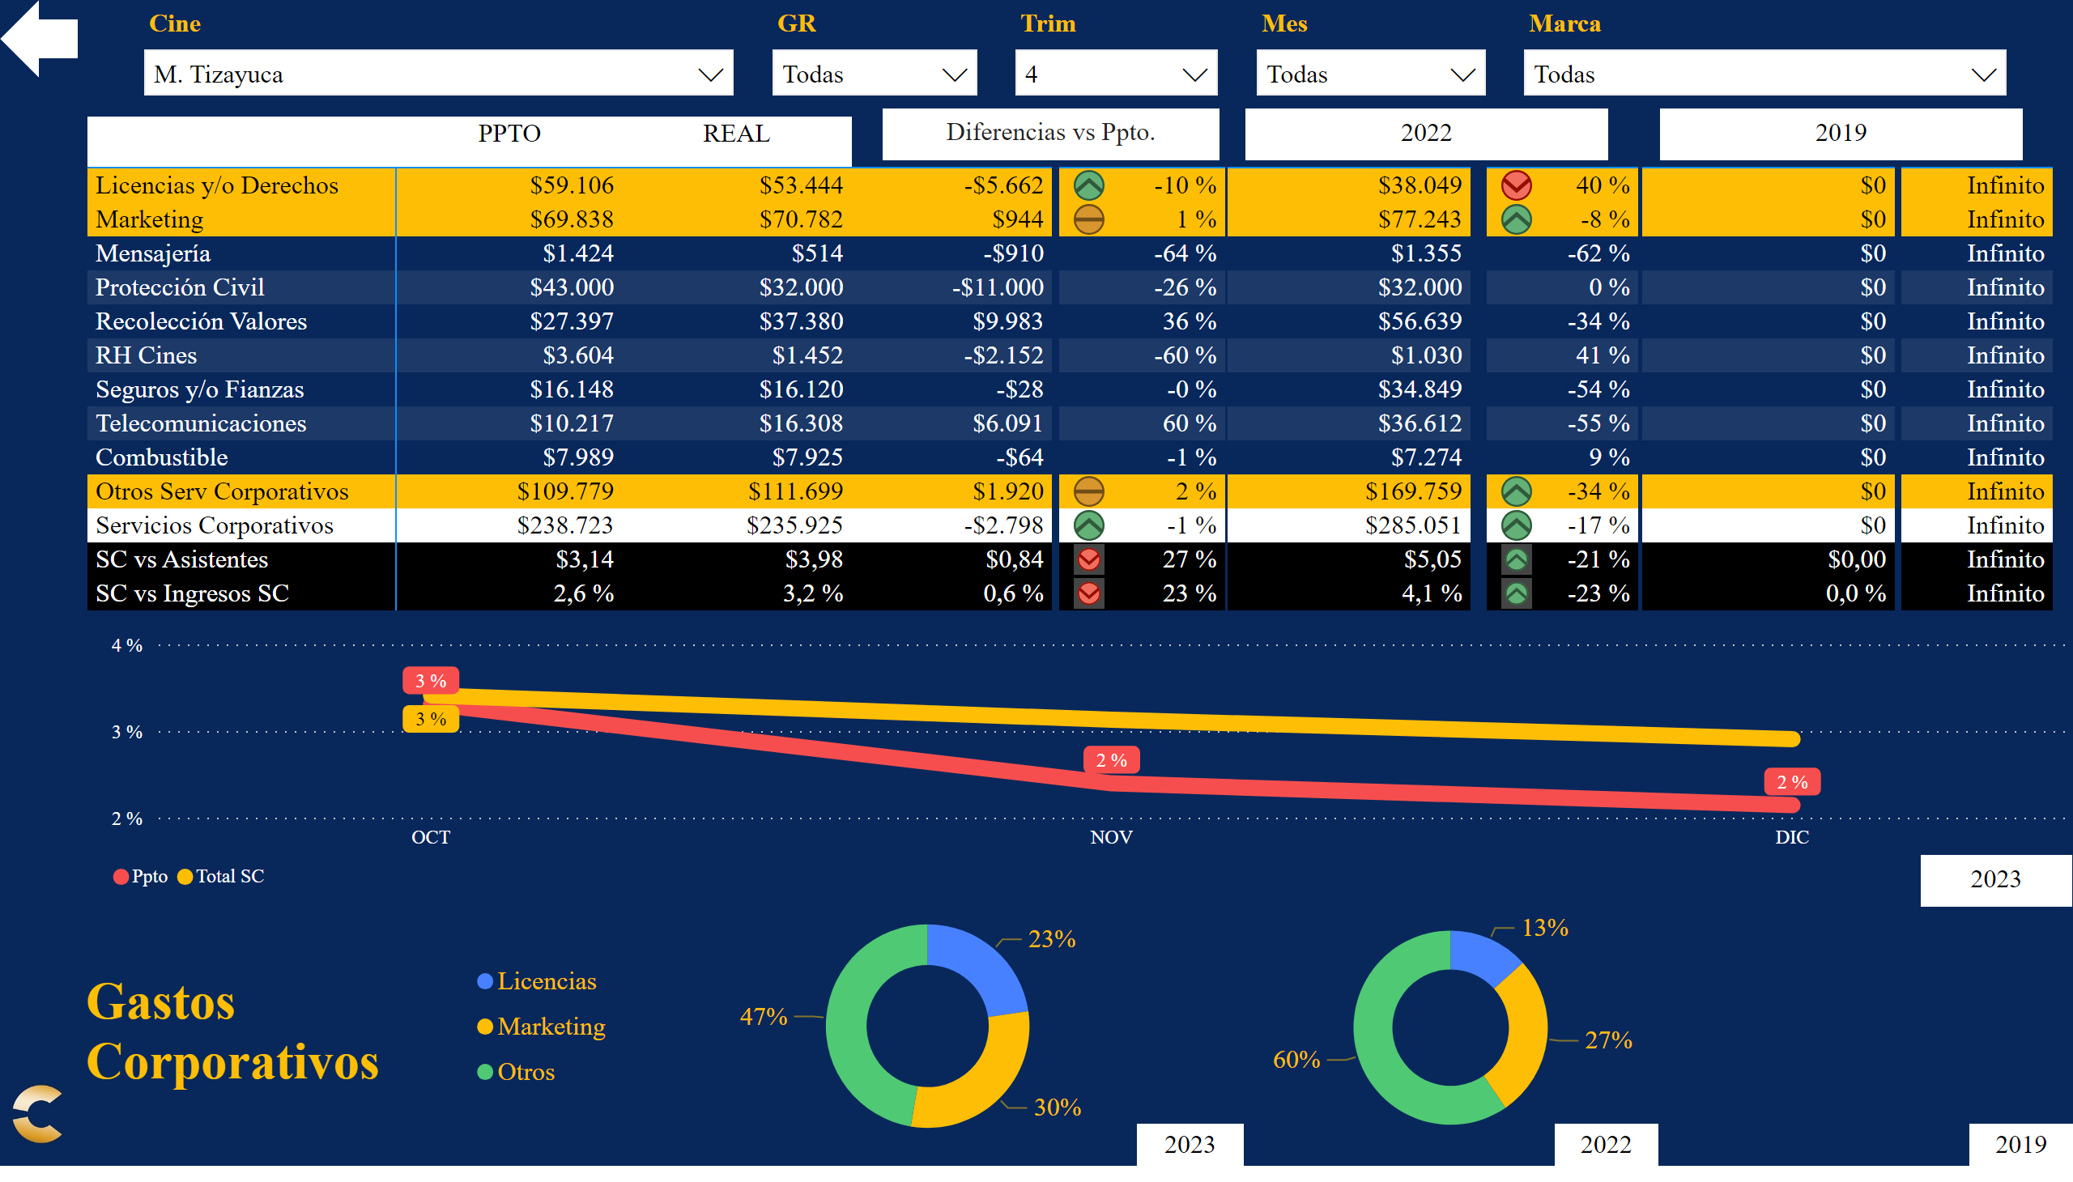
SCO
Notes:
textbox
No alt text provided
Datos Principales
No alt text provided
Dif Ppto
No alt text provided
% Ppto
No alt text provided
donutChart
No alt text provided
Tarjeta AA
No alt text provided
donutChart
No alt text provided
Tarjeta Actual
No alt text provided
donutChart
No alt text provided
Tarjeta 19
No alt text provided
Tarjeta AA
No alt text provided
Datos AA
No alt text provided
% AA
No alt text provided
Tarjeta 19
No alt text provided
Datos 19
No alt text provided
% 19
No alt text provided
Lineas % vs Ingresos
No alt text provided
Tarjeta Actual
No alt text provided
slicer
No alt text provided
Sel Trim
No alt text provided
Sel Mes
No alt text provided
slicer
No alt text provided
Sel Región
No alt text provided
slicer
No alt text provided
Sel Marca
No alt text provided
slicer
No alt text provided
Sel Cine
No alt text provided
textbox
No alt text provided
Panel
No alt text provided
Atras
No alt text provided
Logo cnpls
No alt text provided

Slide 19
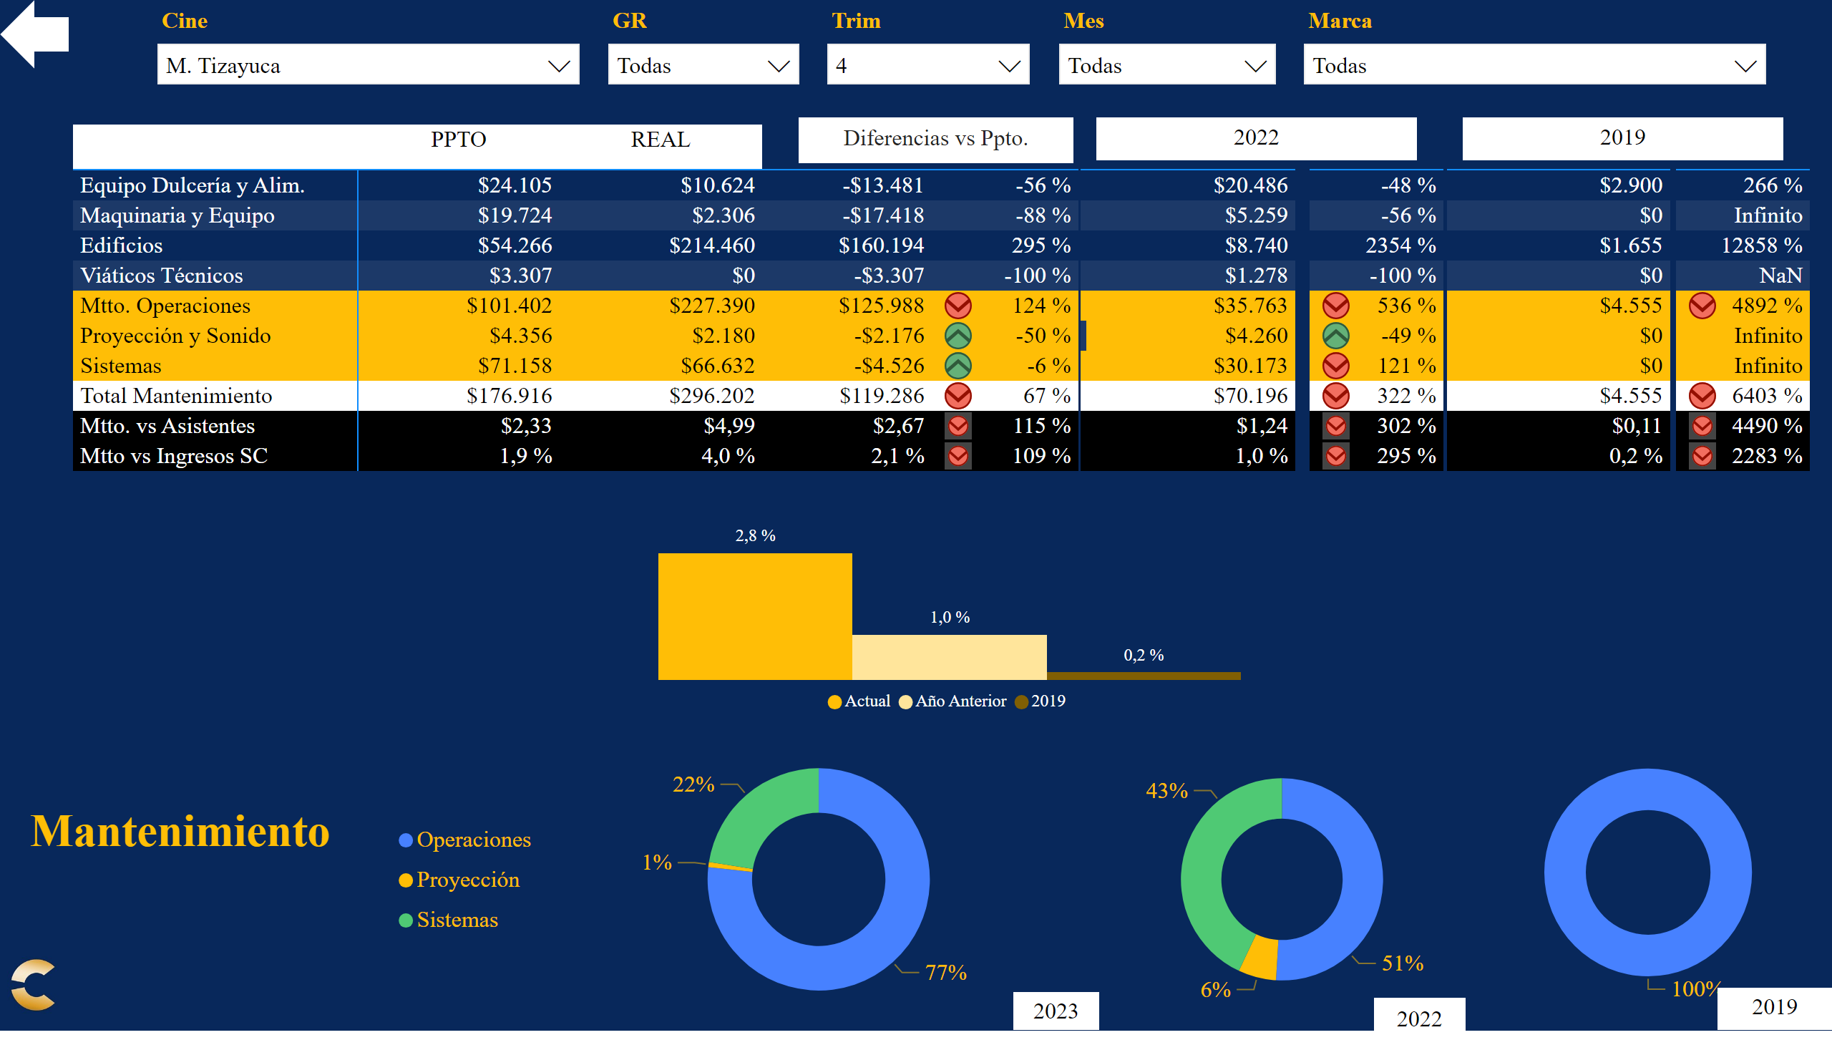
MTO
Notes:
textbox
No alt text provided
Datos Principales
No alt text provided
Dif Ppto
No alt text provided
% Ppto
No alt text provided
donutChart
No alt text provided
Tarjeta AA
No alt text provided
donutChart
No alt text provided
Tarjeta Actual
No alt text provided
donutChart
No alt text provided
Tarjeta 19
No alt text provided
Tarjeta 19
No alt text provided
Datos AA
No alt text provided
% AA
No alt text provided
Tarjeta 19
No alt text provided
Datos 19
No alt text provided
% 19
No alt text provided
Lineas % vs Ingresos
No alt text provided
Sel Marca
No alt text provided
slicer
No alt text provided
Sel Cine
No alt text provided
Sel Región
No alt text provided
slicer
No alt text provided
Sel Mes
No alt text provided
slicer
No alt text provided
slicer
No alt text provided
Sel Trim
No alt text provided
textbox
No alt text provided
Panel
No alt text provided
Atras
No alt text provided
Logo cnpls
No alt text provided

Slide 20
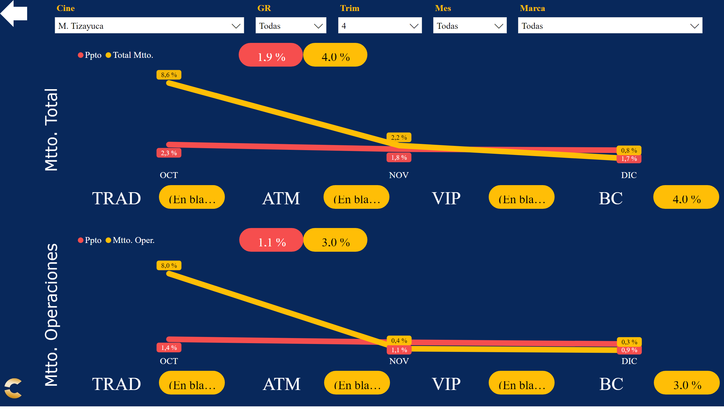
MTOG
Notes:
slicer
No alt text provided
Sel Trim
No alt text provided
Sel Mes
No alt text provided
slicer
No alt text provided
Sel Región
No alt text provided
slicer
No alt text provided
Sel Marca
No alt text provided
slicer
No alt text provided
Sel Cine
No alt text provided
Panel
No alt text provided
Atras
No alt text provided
Logo cnpls
No alt text provided
REA
No alt text provided
Título
No alt text provided
PPT
No alt text provided
TRA
No alt text provided
TRA1
No alt text provided
TRA
No alt text provided
TRA1
No alt text provided
TRA
No alt text provided
TRA1
No alt text provided
TRA
No alt text provided
TRA1
No alt text provided
Gráfica
No alt text provided
REA
No alt text provided
Título
No alt text provided
PPT
No alt text provided
TRA
No alt text provided
TRA1
No alt text provided
TRA
No alt text provided
TRA1
No alt text provided
TRA
No alt text provided
TRA1
No alt text provided
TRA
No alt text provided
TRA1
No alt text provided
Gráfica
No alt text provided

Slide 21
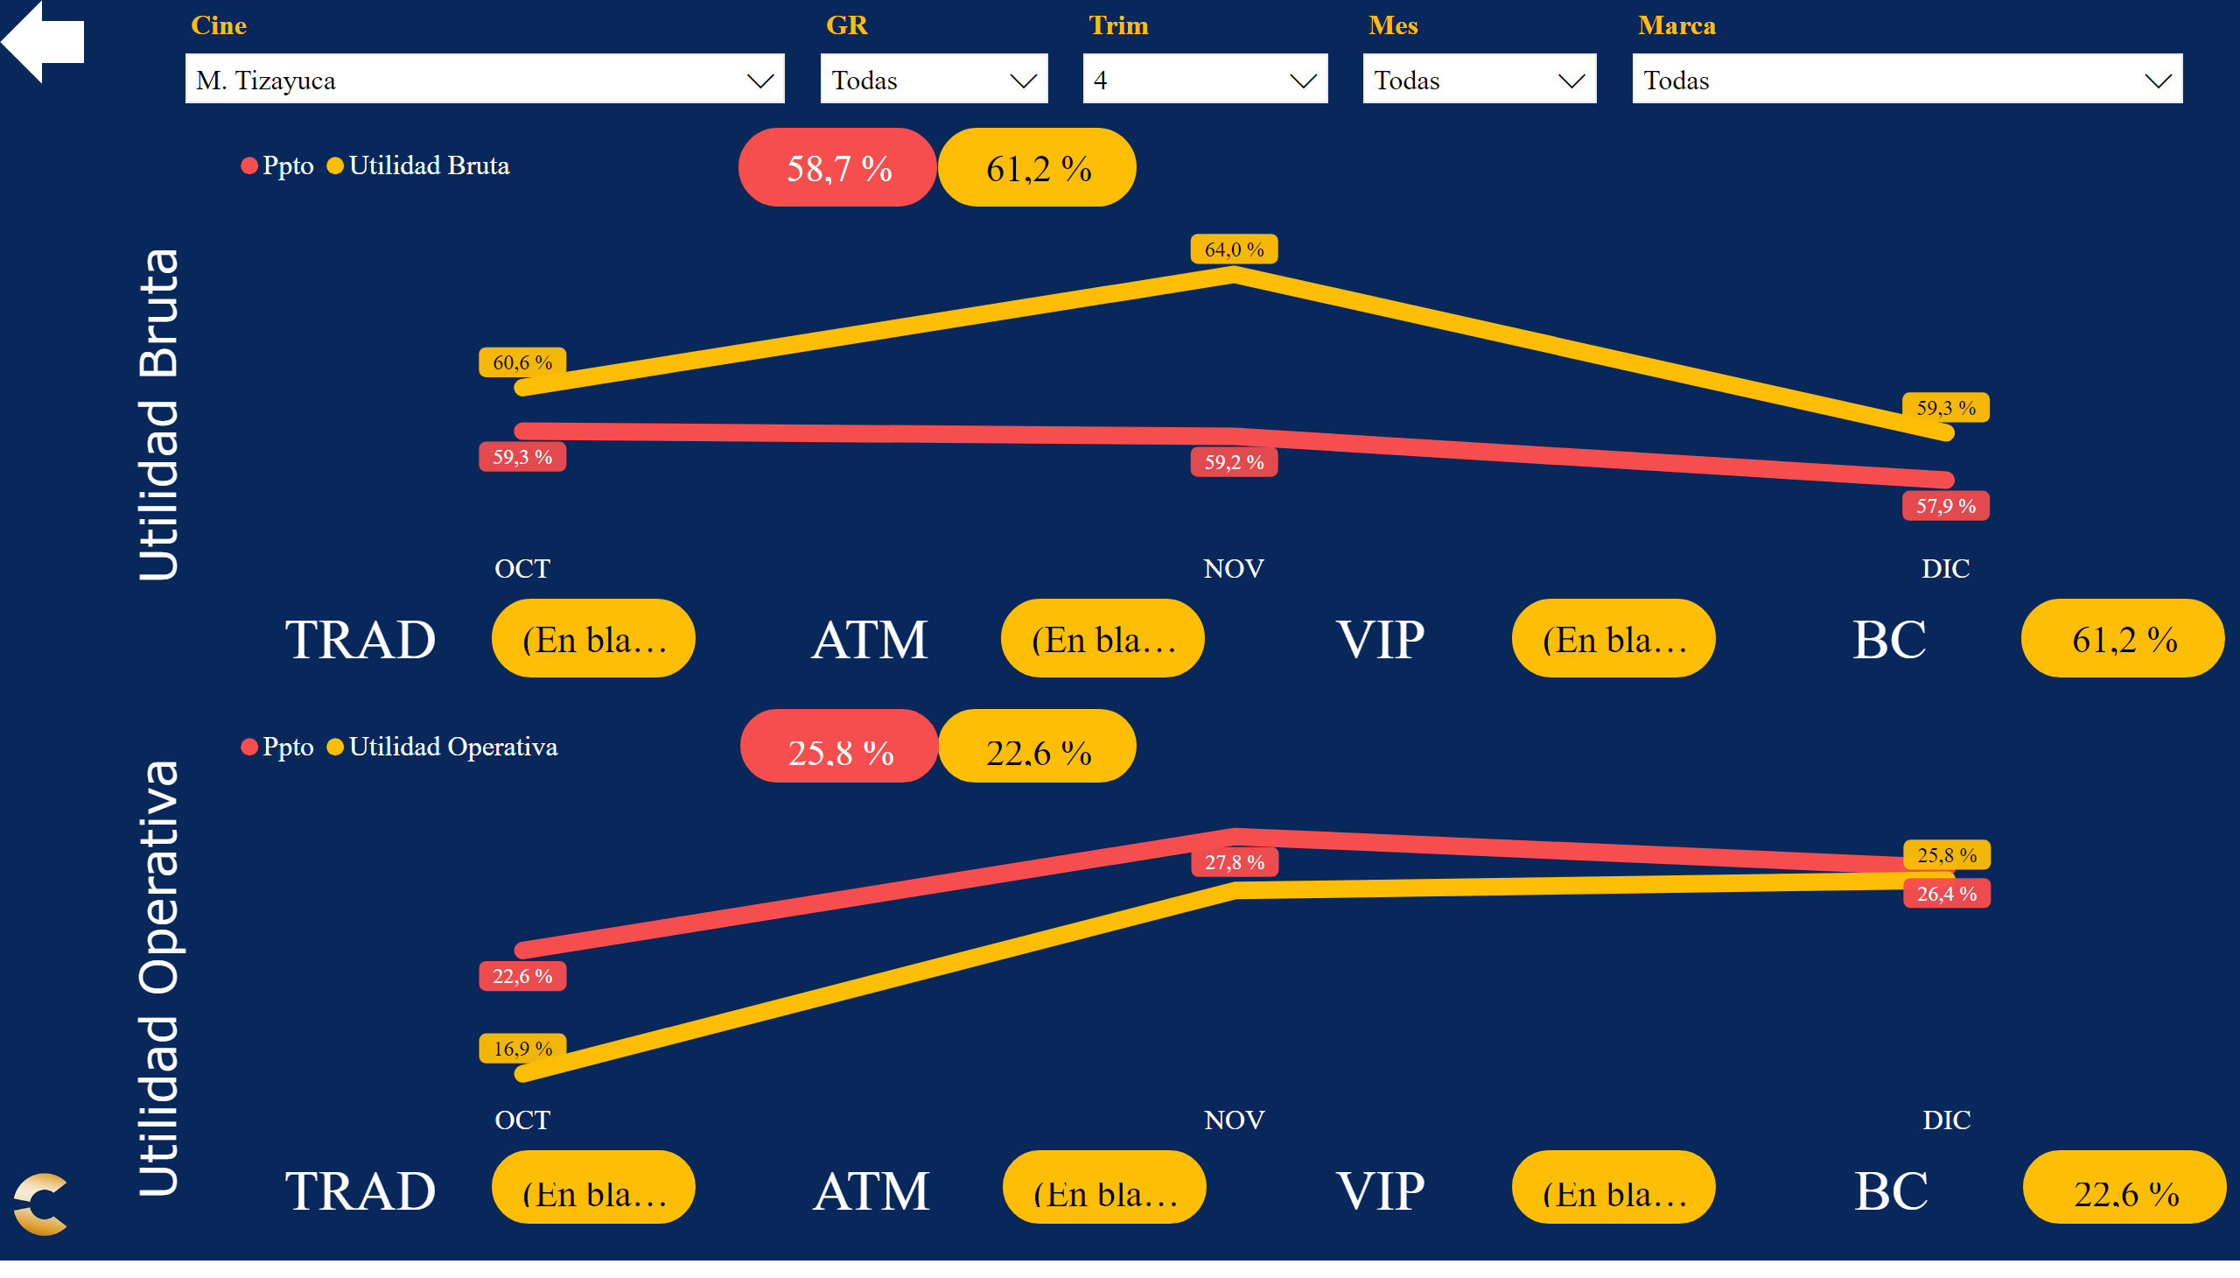
UTG
Notes:
slicer
No alt text provided
Sel Trim
No alt text provided
Sel Mes
No alt text provided
slicer
No alt text provided
Sel Región
No alt text provided
slicer
No alt text provided
Sel Marca
No alt text provided
slicer
No alt text provided
Sel Cine
No alt text provided
Panel
No alt text provided
Atras
No alt text provided
Logo cnpls
No alt text provided
REA
No alt text provided
Título
No alt text provided
PPT
No alt text provided
TRA
No alt text provided
TRA1
No alt text provided
TRA
No alt text provided
TRA1
No alt text provided
TRA
No alt text provided
TRA1
No alt text provided
TRA
No alt text provided
TRA1
No alt text provided
Gráfica
No alt text provided
REA
No alt text provided
Título
No alt text provided
PPT
No alt text provided
TRA
No alt text provided
TRA1
No alt text provided
TRA
No alt text provided
TRA1
No alt text provided
TRA
No alt text provided
TRA1
No alt text provided
TRA
No alt text provided
TRA1
No alt text provided
Gráfica
No alt text provided

